Slide 1
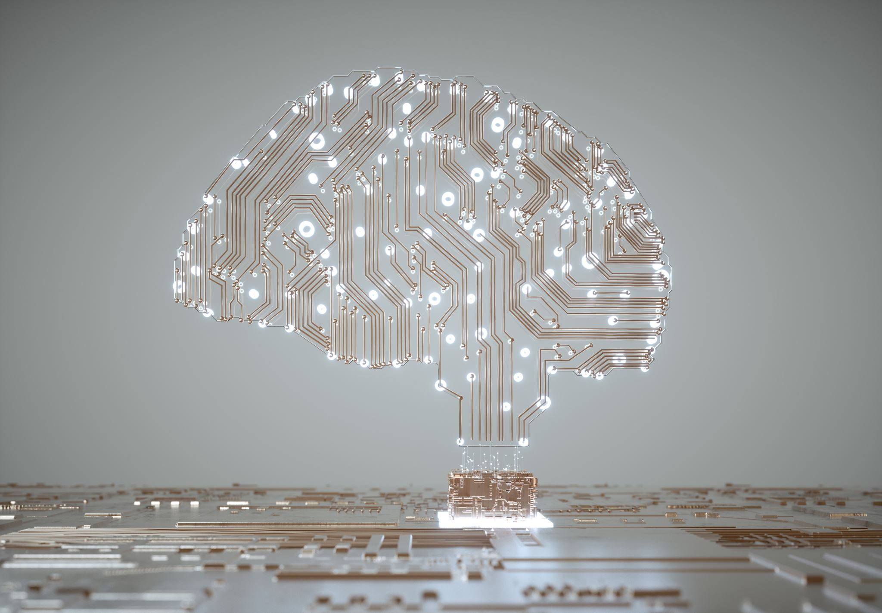
The Rise of Artificial Intelligence
Presented by: Anwesh Mahanta
Class – 9th

Slide 2
Introduction to AI
• AI is the simulation of human intelligence by machines.
• It includes learning, reasoning, and self-correction.

Slide 3

History of AI
1950s
Turing Test by Alan Turing.
1956
Term 'AI' coined at Dartmouth.
2010s
Breakthroughs in deep learning & data.

Slide 4
Applications of AI
• Healthcare: Disease detection, robot surgery.
• Transport: Autonomous vehicles.
• Education: Personalized learning systems.

Slide 5
Benefits & Challenges
Benefits:
• Speed, accuracy, automation, 24/7 operation.
Challenges:
• Bias, job loss, ethical dilemmas.

Slide 6
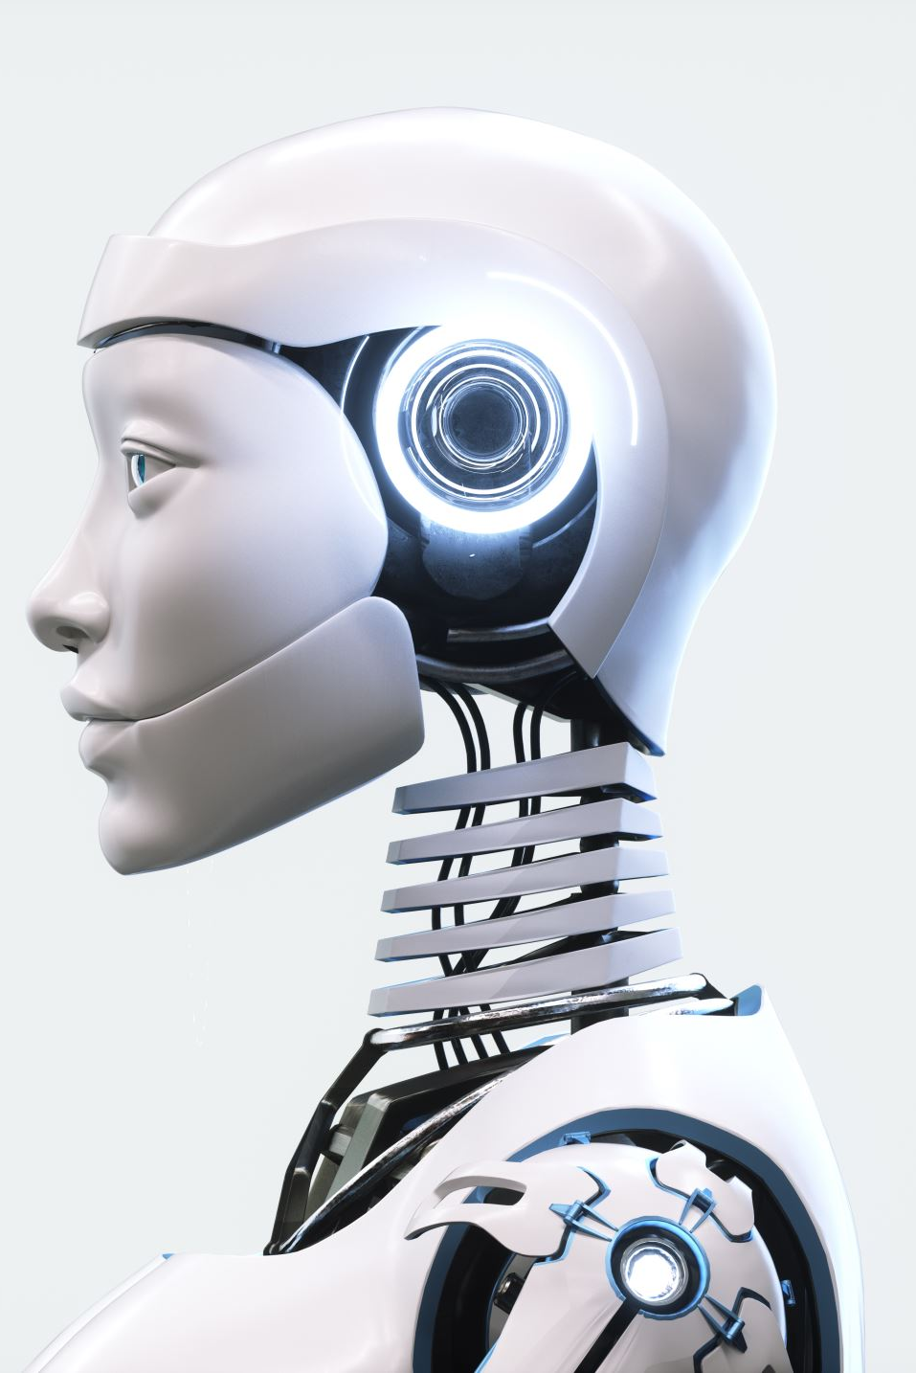
Future of AI
• AI will enhance human capabilities.
• Rise of General AI & humanoid robots.
• Need for ethical guidelines and policies.

Slide 7
Conclusion
• AI is reshaping industries and lifestyles.
• A powerful tool if used responsibly.

